Slide 1
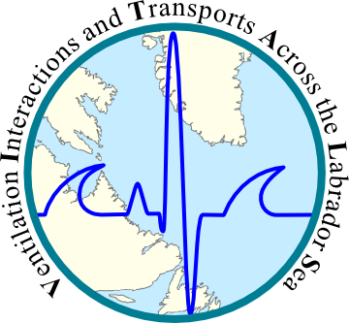


Freshwater Transport into the Interior of the Labrador Sea: A Modelling Study
Clark Pennelly
Paul G. Myers
Xianmin Hu
Department of Earth and Atmospheric Sciences
University of Alberta

Slide 2
Outline
Freshwater in the Labrador Sea
Numerical configurations
Transport terms: mean/eddy/total
Calculation of freshwater exchange across isobaths
Preliminary results
Eddy permitting vs. eddy resolving
Isobath depth
Seasonality

Slide 3
Labrador Sea Freshwater
The Labrador Sea contains a region of deep convection; an important link between the atmosphere and the deep ocean
An increase in freshwater into the interior increases stratification and can dampen convection strength
w/o FW input
w/ FW input
Atmosphere
Ocean

Slide 4
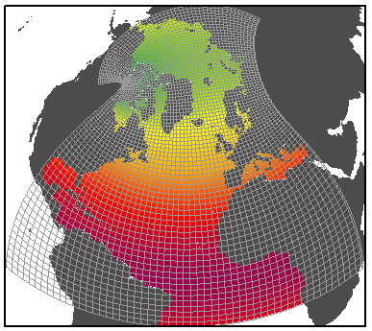
NEMO Simulation Settings
ANHA:
Arctic Northern Hemisphere Atlantic
NEMO version 3.4
Ice Model: LIM2
50 vertical levels
Open Boundaries: Bering strait, 20°S
Initial Conditions: (3D) T, S, U, V, and (2D) SSH, Ice
Forcing: Hourly wind, rain, snow, LW/SW, air temp, air humidity from Environment Canada- GDPS

Slide 5
AGRIF: Adaptive Grid Refinement In Fortran¹
Control
Grid Box
1/4°
1/12°
1/4°
AGRIF
Transformation
(1:3 ratio)
1/12°
AGRIF Grid Boxes
Parent
High Resolution Simulation
1/4°
X:814
AGRIF
1/12°
Y:544
Y:180
X:270
¹Debreu, Laurent, Christophe Vouland, and Eric Blayo. "AGRIF: Adaptive grid refinement in Fortran." Computers & Geosciences 34.1 (2008): 8-13.

Slide 6
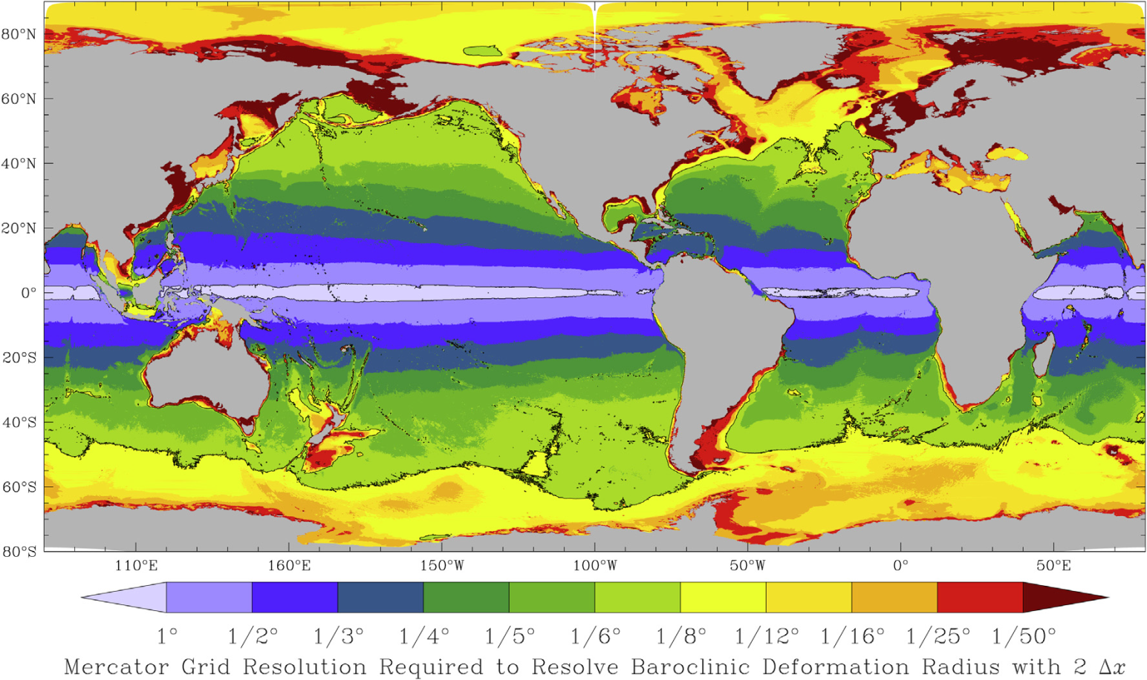
Why use Nests?
High resolution is needed to resolve eddies
Hallberg (Ocean Mod. 2013)
More realistic simulation of small scale features: bathymetry, boundary currents, etc
Computationally cheaper than high resolution across entire domain

Slide 7
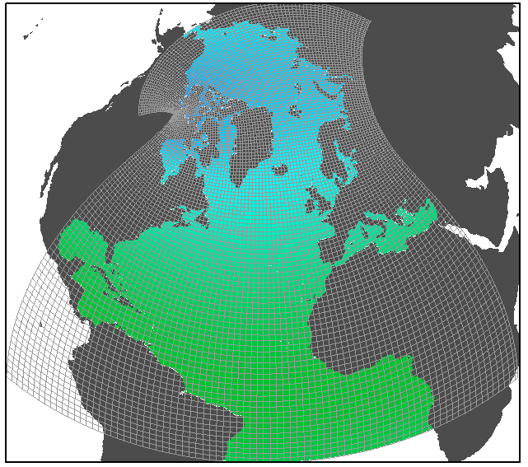
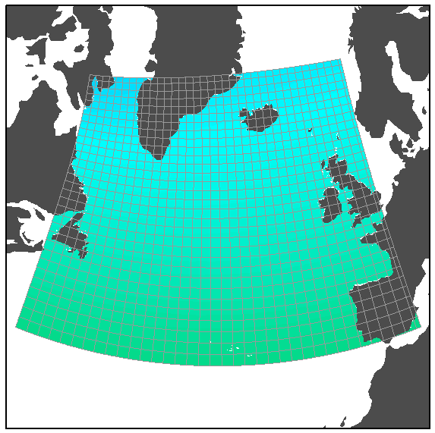
Simulations 2002-2015
ANHA12
Currently at 2003
ANHA4
Horizontal mesh
(km)
0
5
10
15
20
25
30
Configuration | ANHA4 | ANHA12 | AGRIF12
Time step | 1080s | 180s | 540s : 180s
Horz. Resolution | 1/4° | 1/12° | 1/4° : 1/12°
Simulation time | ~4 days | 54+ days | ~28 days
CPUs used | 64 | 256 | 48
Core years | 0.7 | 37.8 | 3.7
Currently at 2005
AGRIF12

Slide 8
Freshwater Transport Terms
Total transport:
Transport associated with ocean velocity: u and v
Mean transport:
Transport associated with a time average (25 days) of the ocean velocity: u and v
Eddy transport:
Transport associated with the difference between the velocity and the time average of the velocity: u – u, v - v

Slide 9
Exchange Across Isobaths
Examine the total freshwater transport (relative to 34.8 g/kg) across isobaths, integrated from seafloor to ocean surface
Example
crossing 500m
Freshwater:
0m
100m
200m
300m
400m
500m
600m
Cell depth
u/v
Transport:
Freshwater * velocity * Surface Area
Cell width

Slide 10
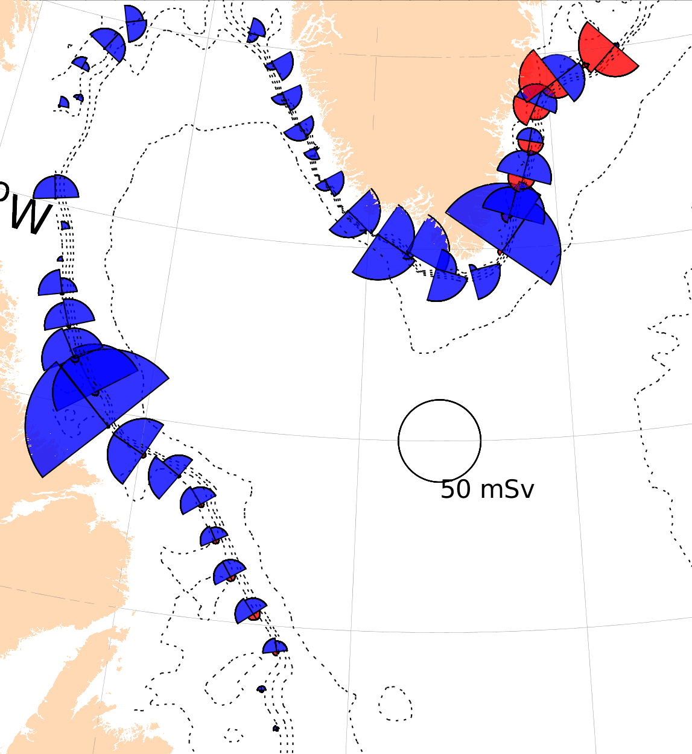
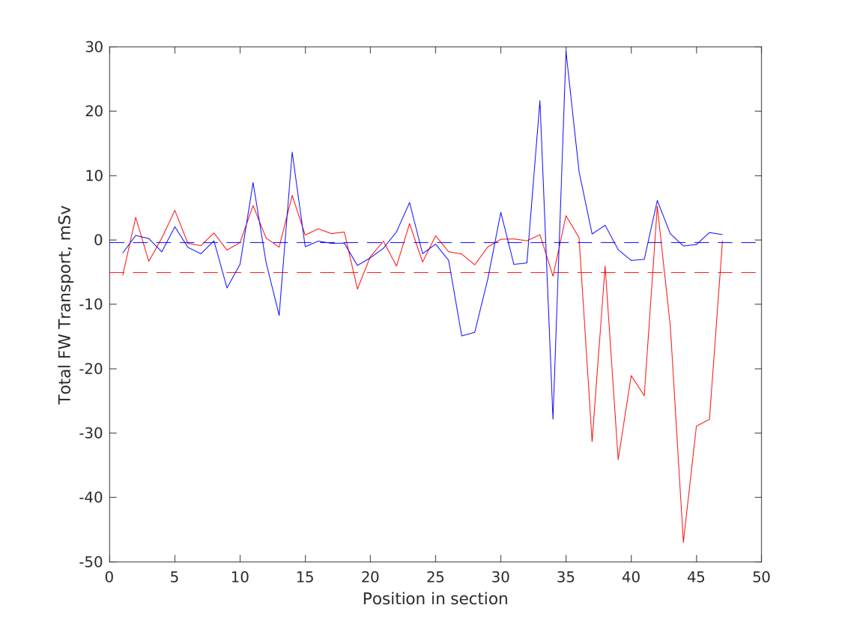
Results: Total FW Transport
ANHA4 Year 2008 Total FW transport 500m
Saline Transport
FW transport
Off-shelf transport
On-Shelf transport

Slide 11
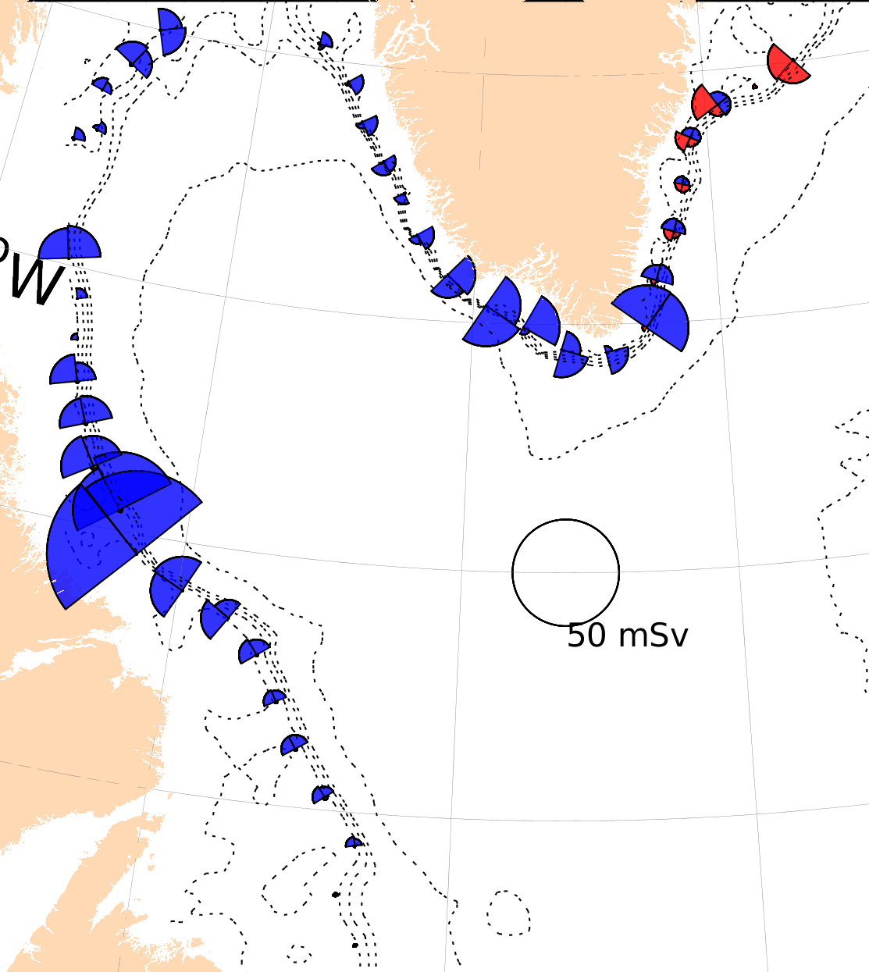
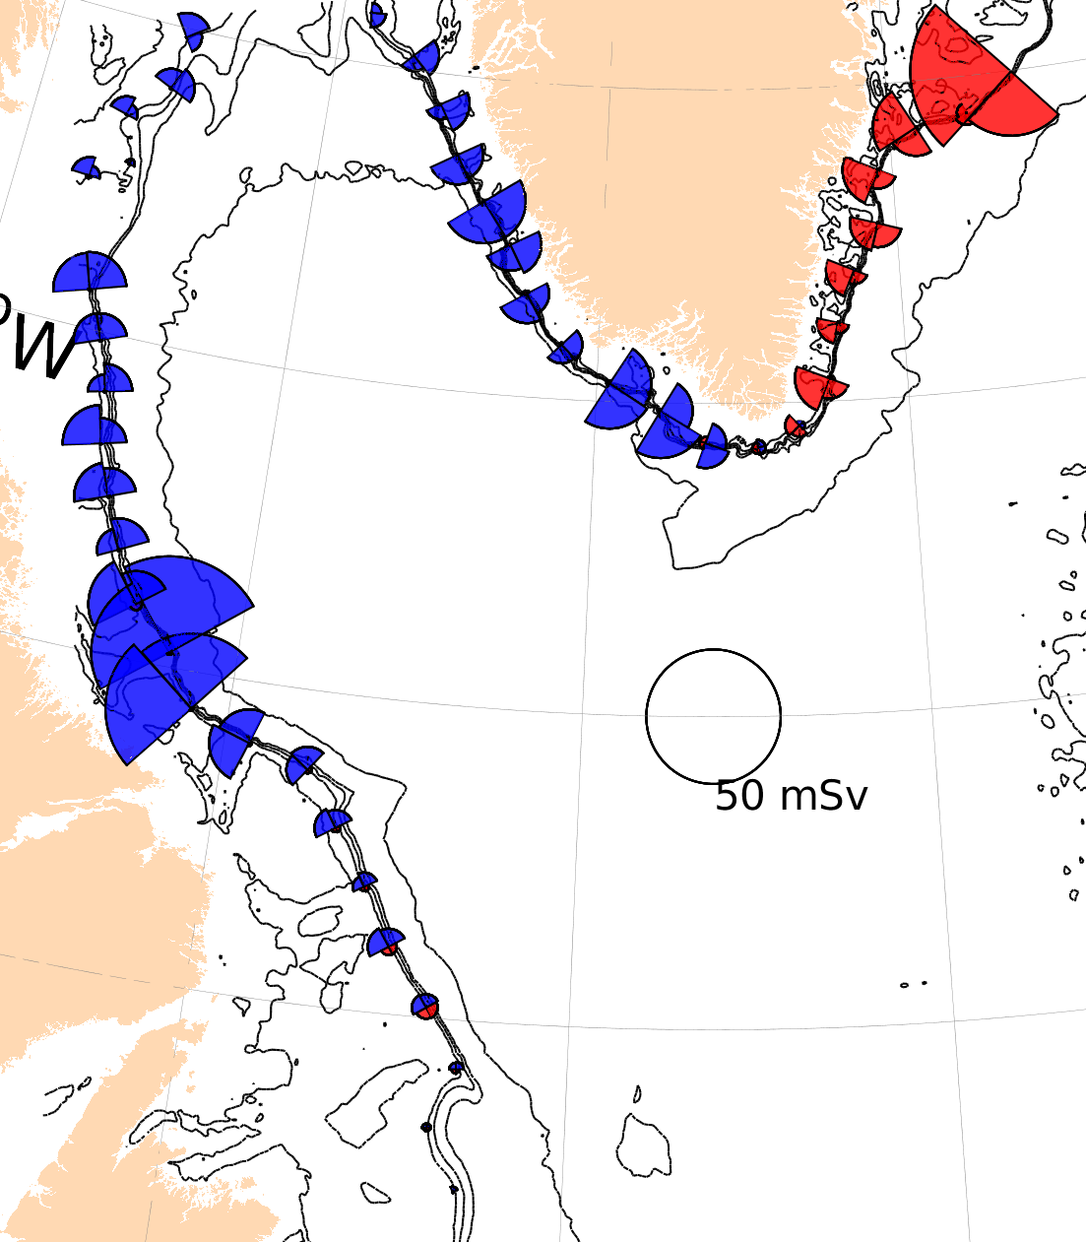
Eddy-Permitting Vs Eddy-Resolving
Year 2004 spring 500m Total FW transport
1/4°
1/12°

Slide 12
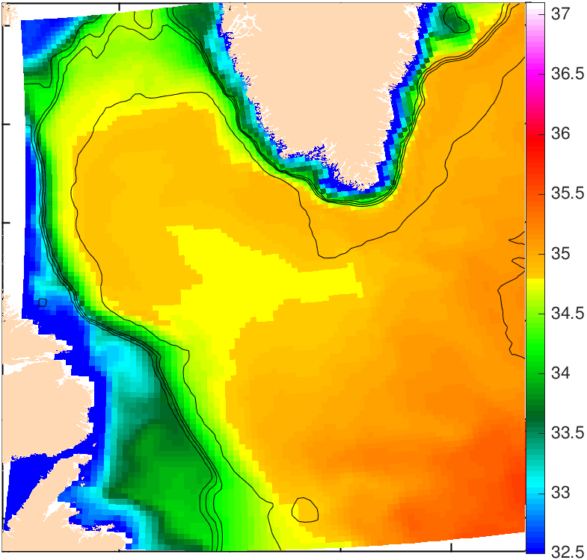
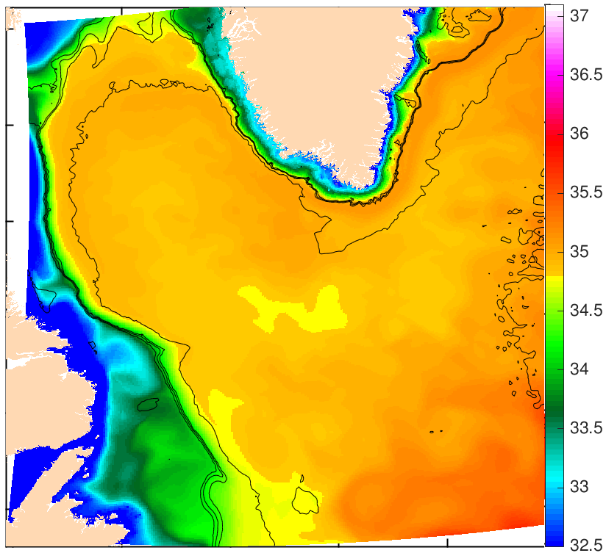
Ocean Salinity
Salinity average across the top 200m
1/4°
1/12°

Slide 13
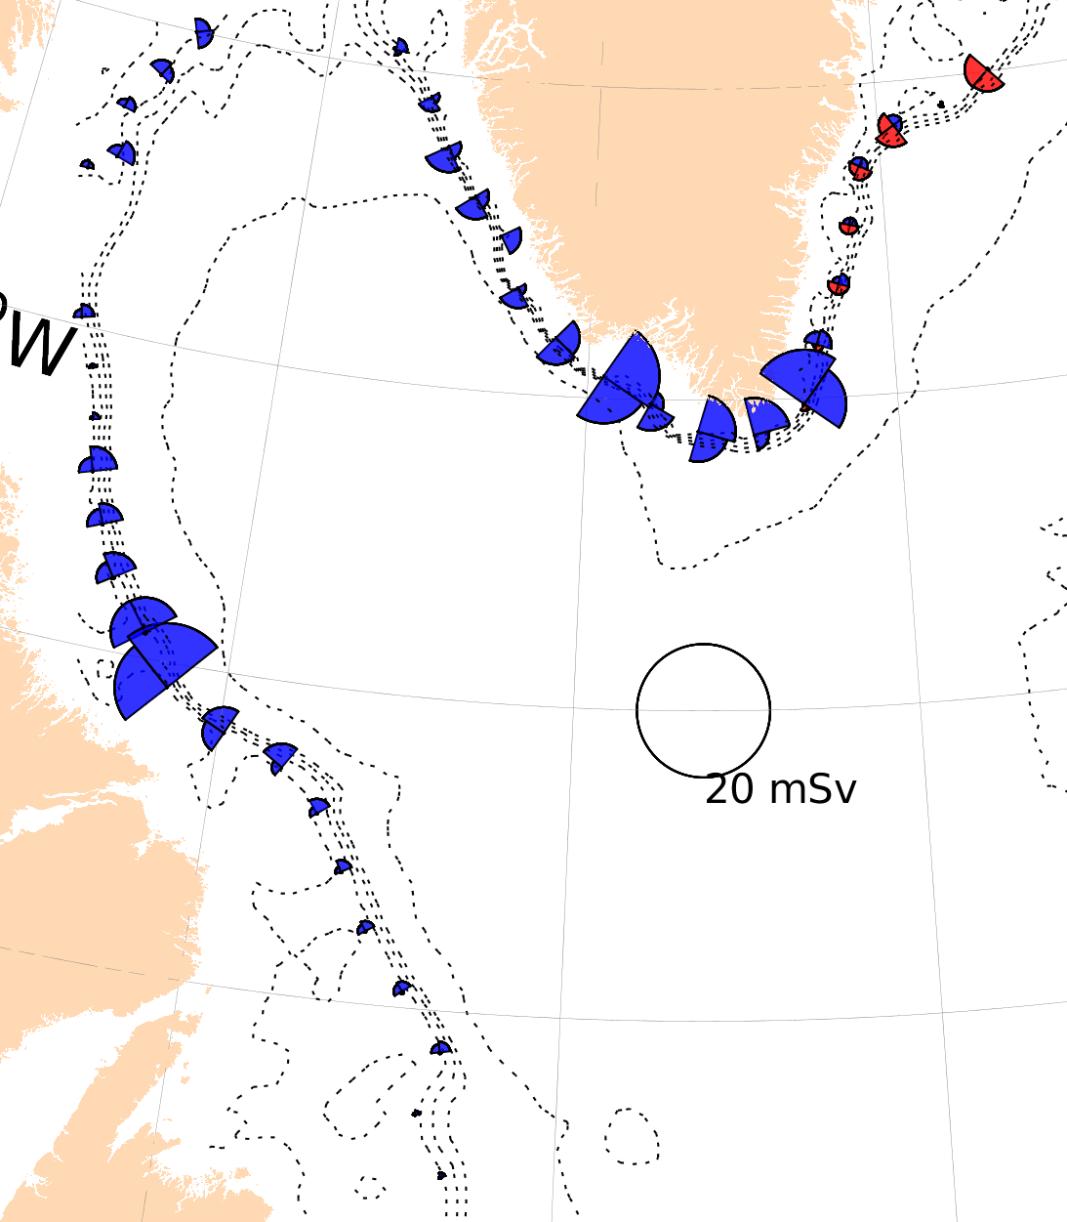
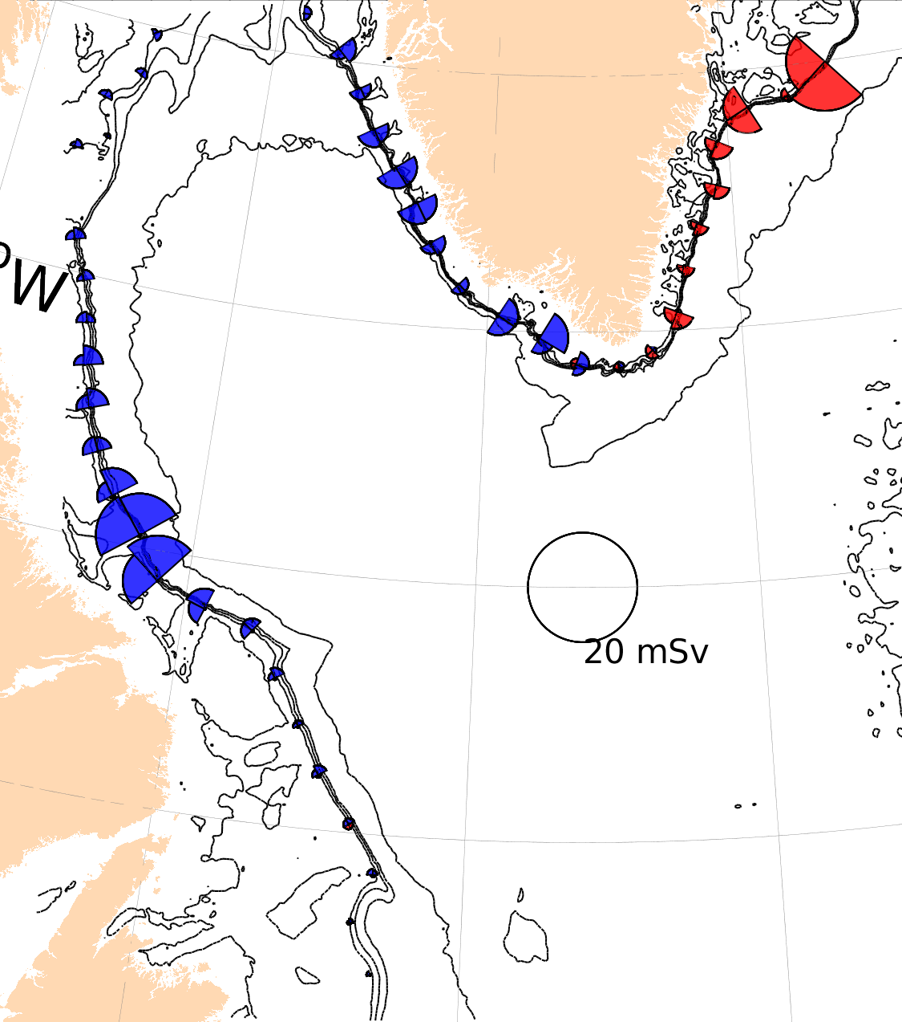
Eddy-Permitting Vs Eddy-Resolving
Year 2004 spring 500m Eddy FW transport
1/4°
1/12°

Slide 14
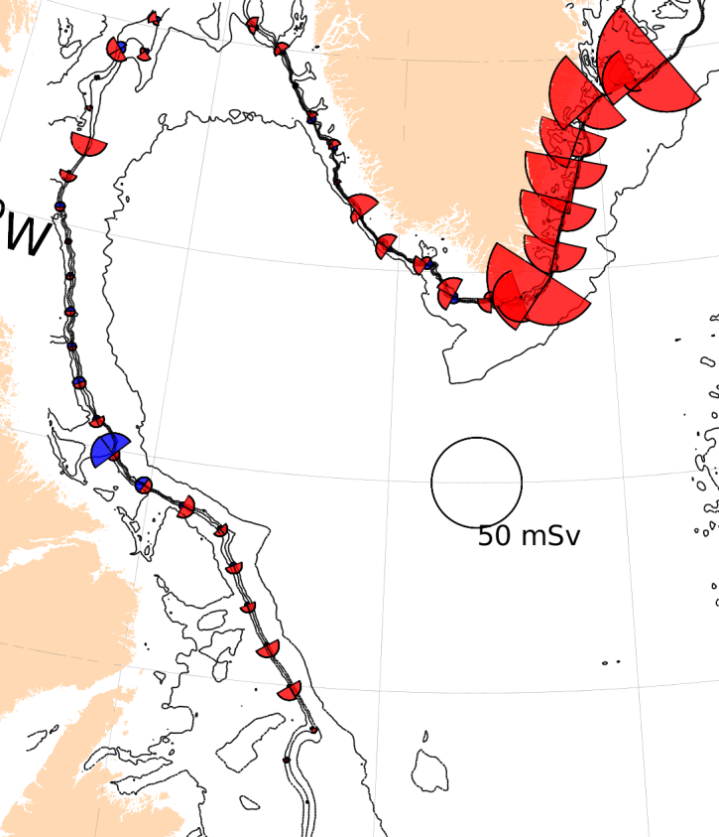
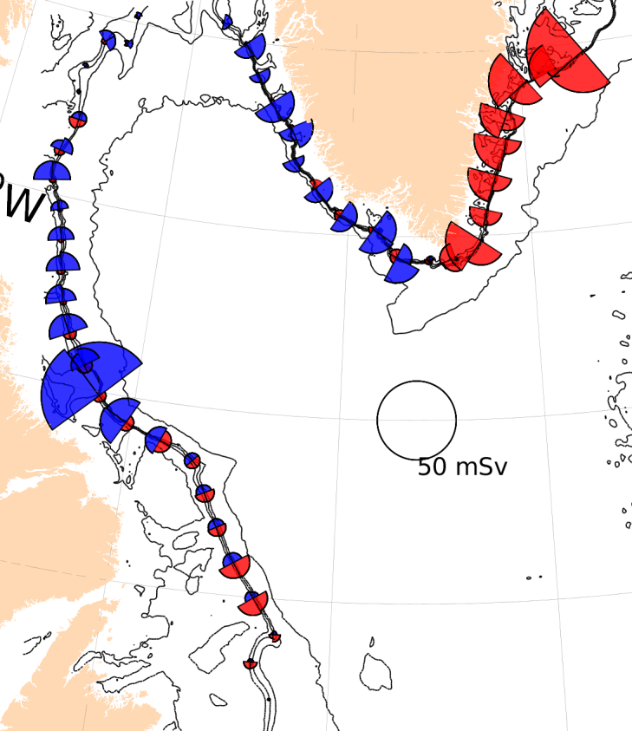
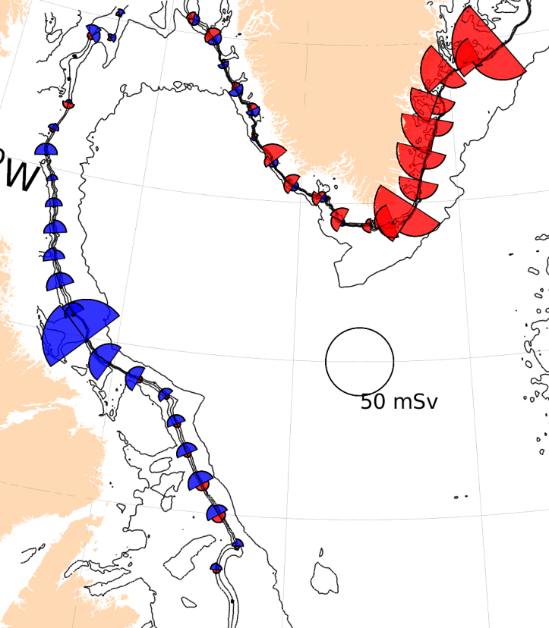
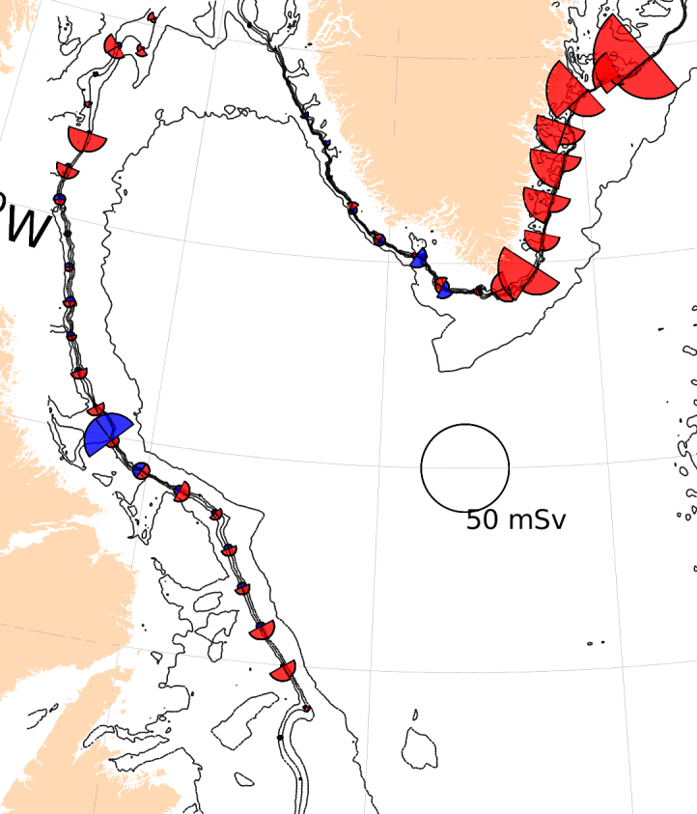
Winter
Spring
Seasonality
Summer
Fall

Slide 15
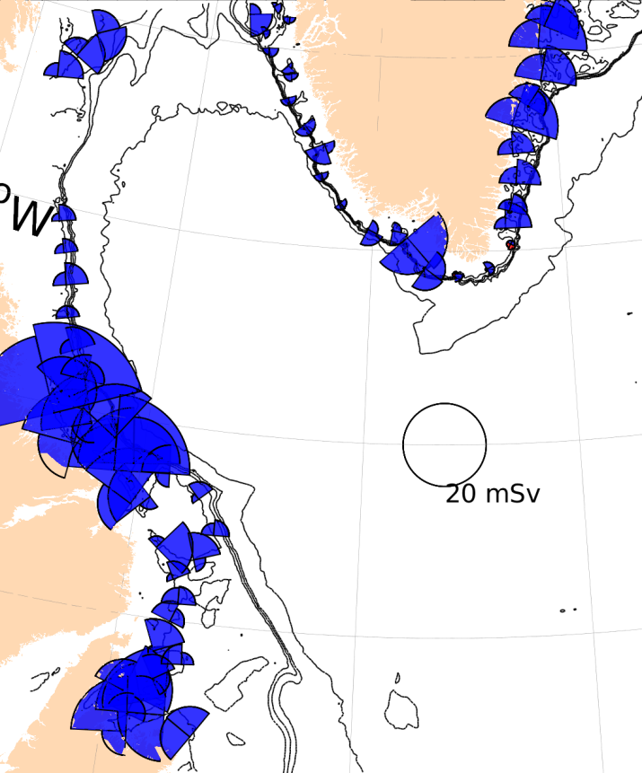
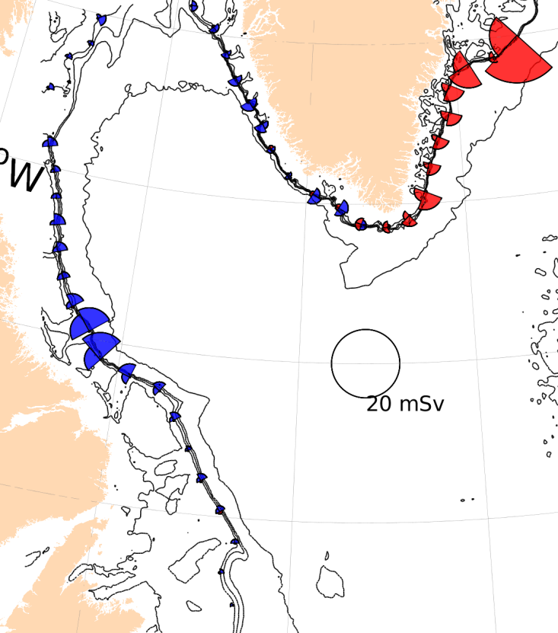
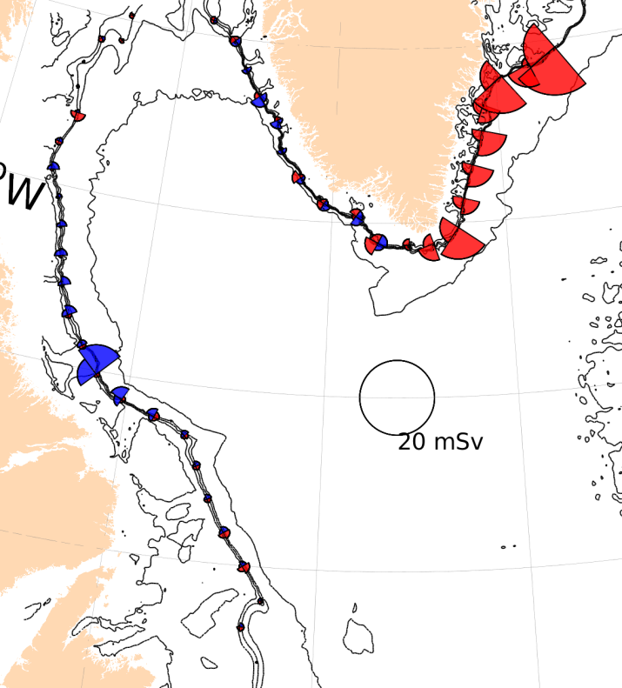
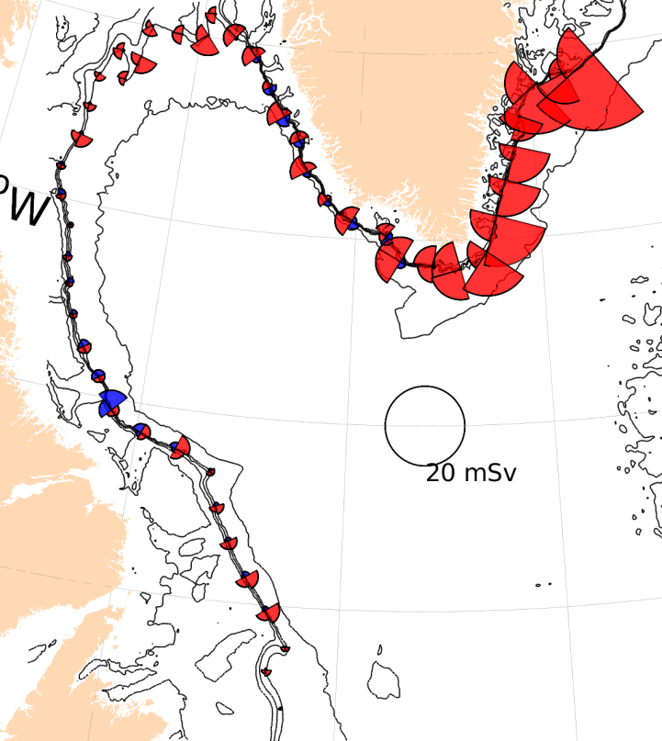
Isobaths
250m
500m
750m
1000m

Slide 16
Summary
Examine the freshwater transport across isobaths in the Labrador Sea
Eddy-permitting simulation (1/4°) and eddy-resolving simulations (1/12°)
Mean, eddy, and total freshwater components
Seasonality
Multiple isobaths
Identify freshwater pathways into the interior of the Labrador Sea

Slide 17
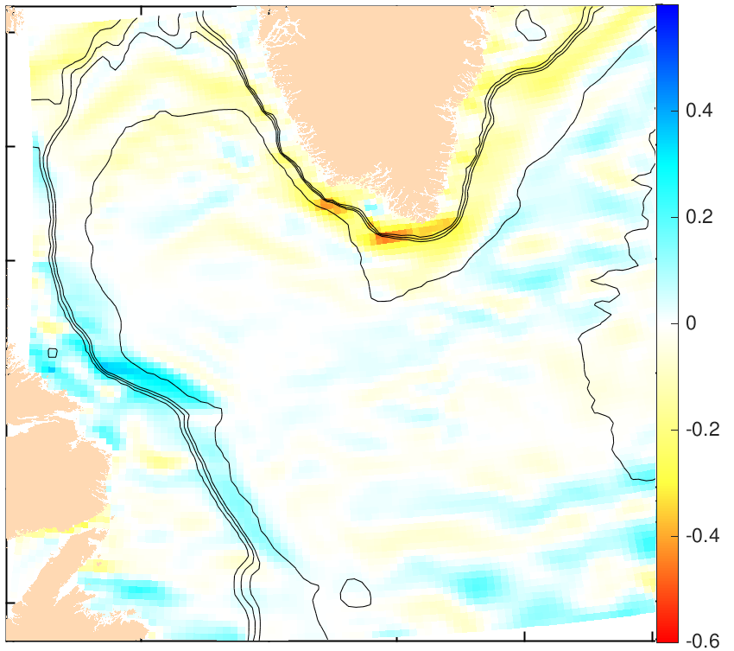
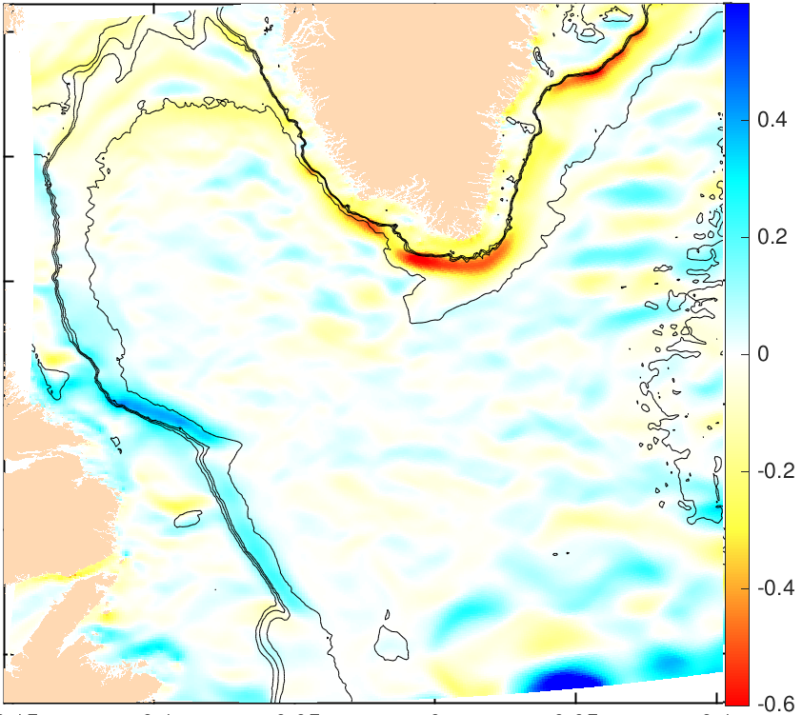
Zonal velocity
1/4°
1/12°

Slide 18
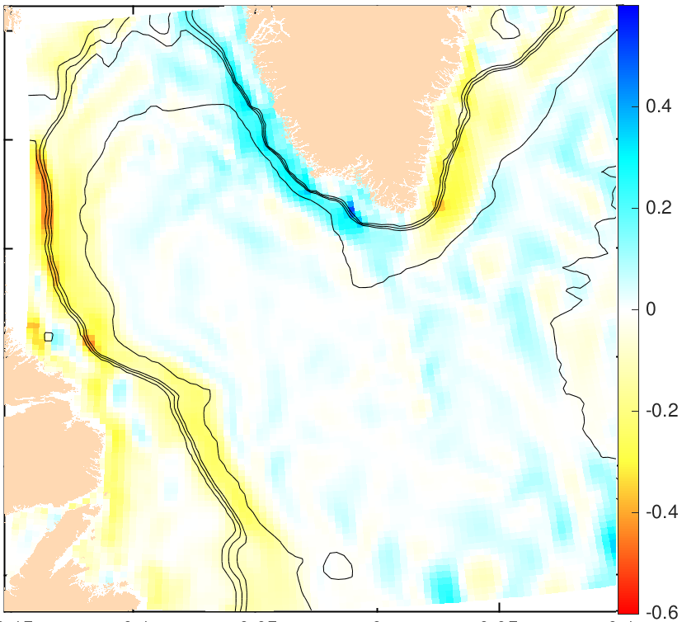
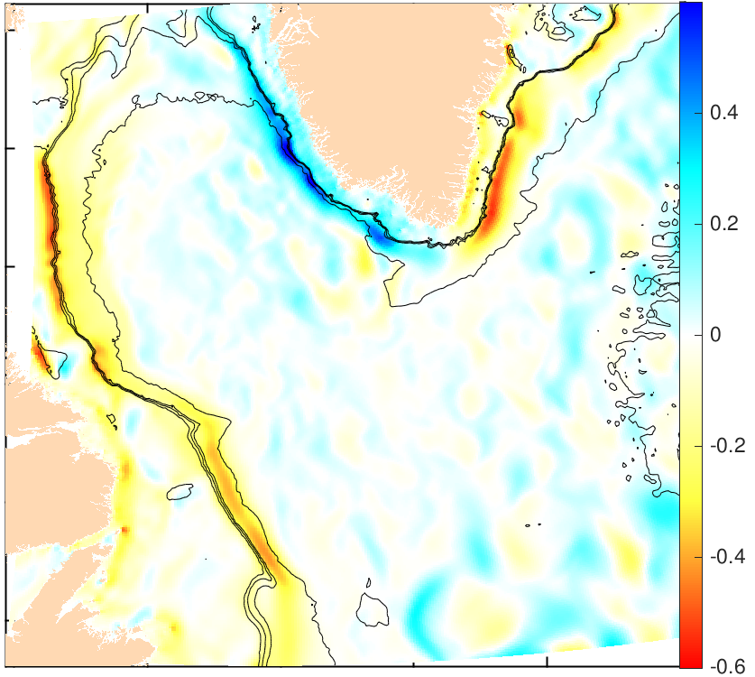
Meridional velocity
1/4°
1/12°

Slide 19
Mixed Layer Depth

